Slide 1
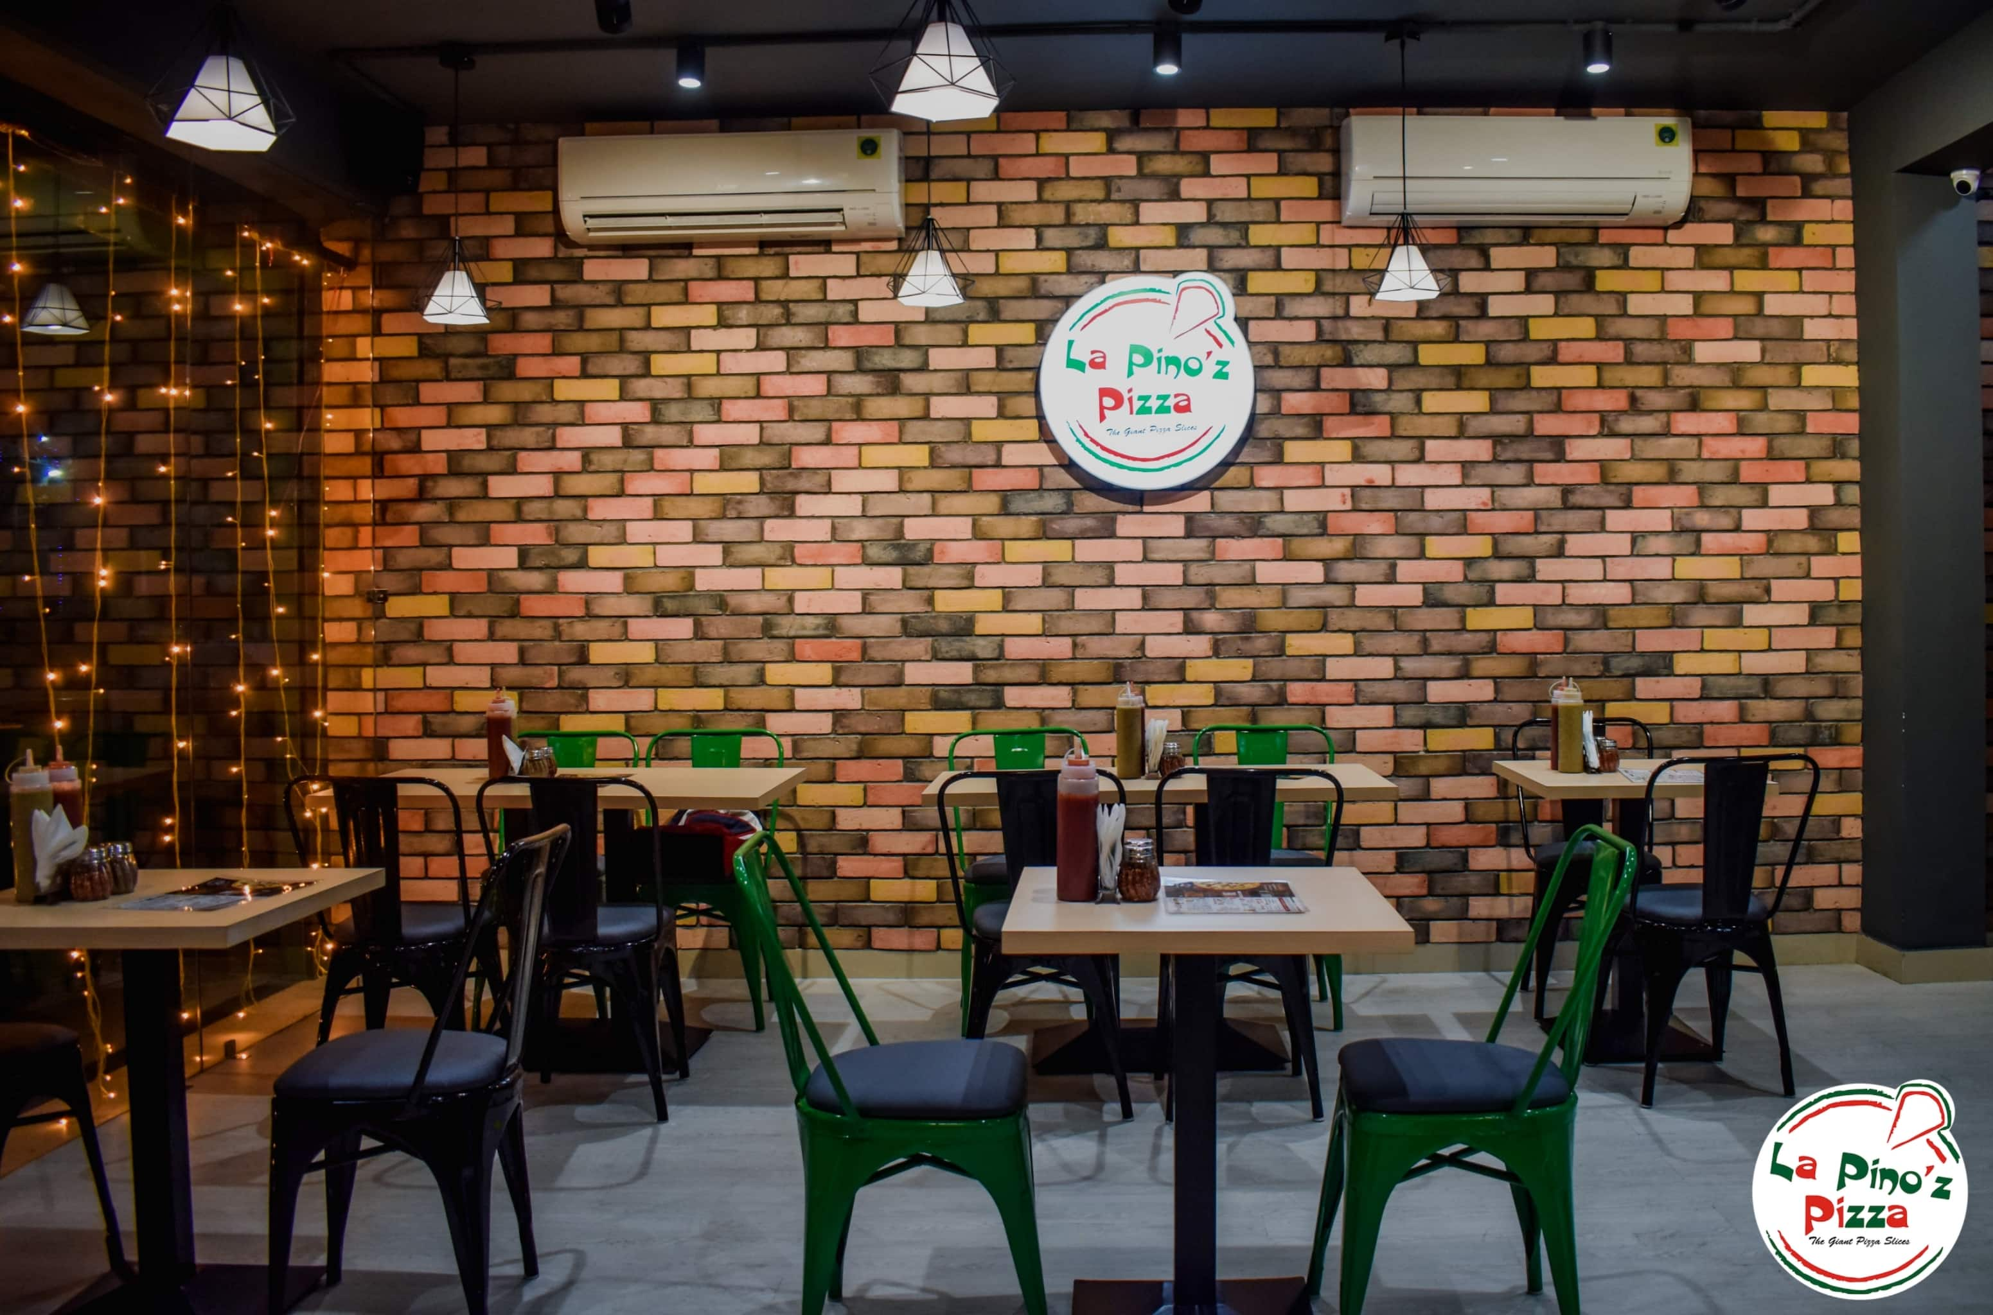



Diving Deep Into The Cheese Analyzing La Pinoz Pizza’s Sales Data
Analyzed and Documented by
Manish Kumar Singh – (A DataGyan Project Initiative – Batch79 – GROUP 2)

Slide 2
PROJECT INTRODUCTION
Our data analysis project focuses on La Pinoz Pizza sales data with the aim of understanding the factors influencing sales and identifying growth opportunities. By analyzing the extensive sales data, we seek to uncover patterns, correlations, and actionable insights to inform business decisions.
This presentation showcases our findings, including key metrics, trends, and correlations. We express our gratitude to La Pinoz Pizza for providing us with access to their data and hope that our insights contribute to their success while serving as a valuable resource for data analysis in the food industry.
Let's explore the world of La Pinoz Pizza sales data and unravel the secrets behind their success!

Slide 3
PROBLEM STATEMENT
We need to analyze key indicators for our Pizza sales data to gain insights into our business performance. Specially, we want to calculate the following metrics:
Total Revenue – The sum of the total price of all the pizza orders.
Average Order Value: The average amount spent per order, calculated by dividing the total revenue by the total number of orders.
Total Pizzas Sold: The sum of the quantities of all the pizza sold.
Total Orders: The total numbers of orders placed.
Average Pizzas Per Order – The average number of pizzas sold per order, calculated by dividing the total number of pizzas sold by the total number of orders.
KPI’s Requirements

Slide 4
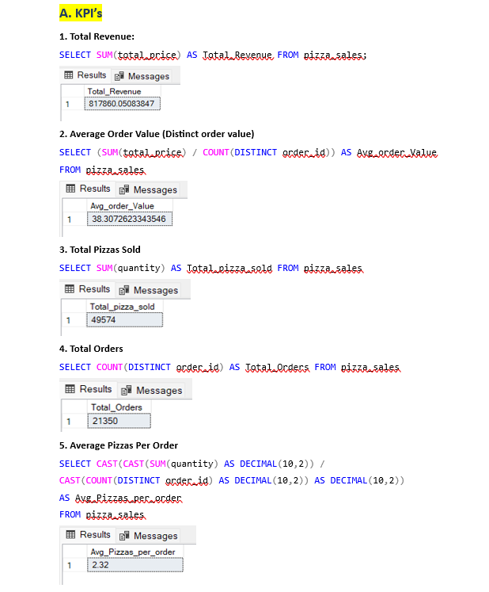
RESOLVING PROBLEM STATEMENT
Solving KPI’s Requirements using SQL

Slide 5
PROBLEM STATEMENT
We would like to visualize various aspects of our pizza sales data to gain insights and understand key trends. We have identified the following requirements for creating charts:
Daily Trend for Total Orders: Create a bar chart that displays the daily trend of total orders over a specific time period. This chart will help us identify any patterns or fluctuations in new order volumes on a daily basis.
Hourly Trend for Total Orders: Create a line chart that illustrates the hourly trend of total orders through out the day. This chart will allow us to identify peak hours or periods of higher order activity.
Percentage of Sales by Pizza Category: Create a pie chart that shows distribution of sales across different pizza categories. This chart will provide insights into the popularity of various Pizza categories and their contribution to overall sales.
Percentage of Sales by Pizza Size: Create a pie chart that represents the percentage of Sales attributed to different pizza sizes. This chart will help us understand customer preferences for pizza sizes and their impact on sales
CHART REQUIREMENT

Slide 6
PROBLEM STATEMENT
5. Total Pizzas Sold by Pizza Category : Create a funnel chart that represents the total number of pizzas sold for each Pizza category. This chart will help us to compare sales performance of different Pizza categories.
6. Top 5 Best Sellers by Total Pizza’s Sold: Create a bar chart highlighting the top 5 best selling Pizzas based on the total number of pizza’s sold. This chart will help us to identify the most popular pizza options.
7. Bottom Seller Pizzas: Create a bar chart showcasing bottom 5 worst selling pizzas based on the total number of pizza’s sold. This chart will help us to identify the underperforming or less popular pizza.
CHART REQUIREMENT

Slide 7
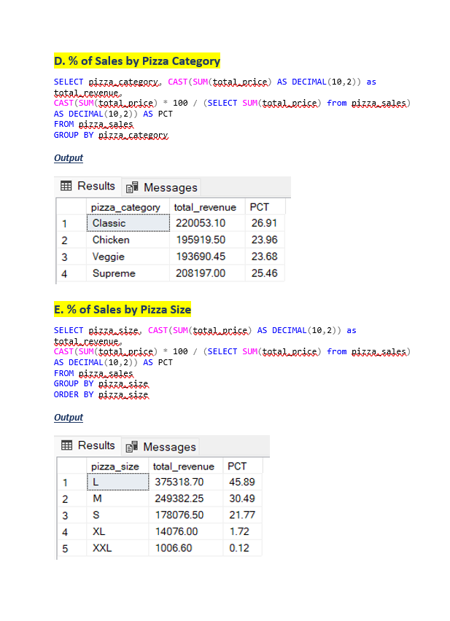
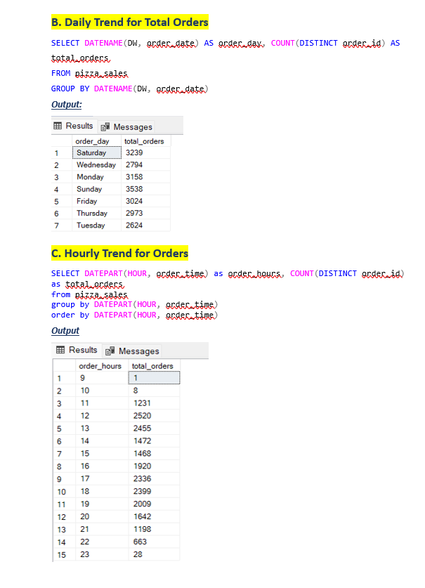
RESOLVING PROBLEM STATEMENT
Solving Chart Requirement Using SQL Queries

Slide 8
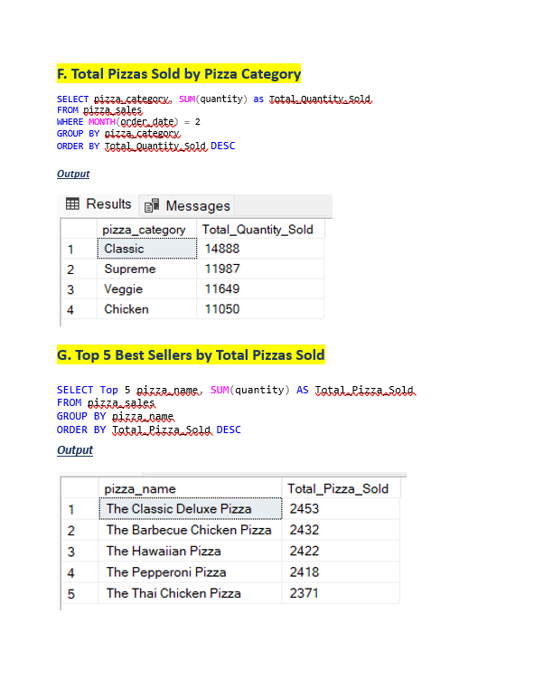
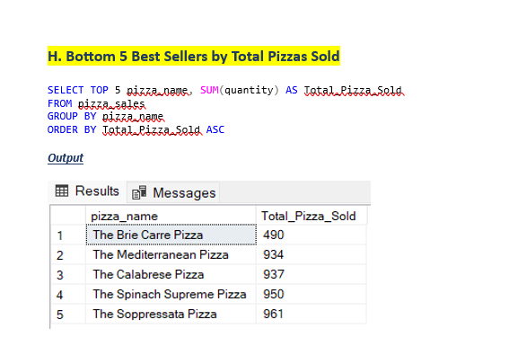
RESOLVING PROBLEM STATEMENT
Solving Chart Requirement Using SQL Queries

Slide 9
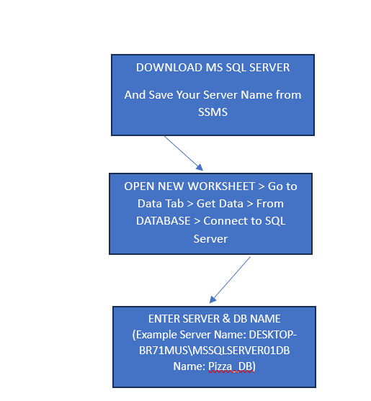
Steps To Import Data From SSMS To Excel

Slide 10
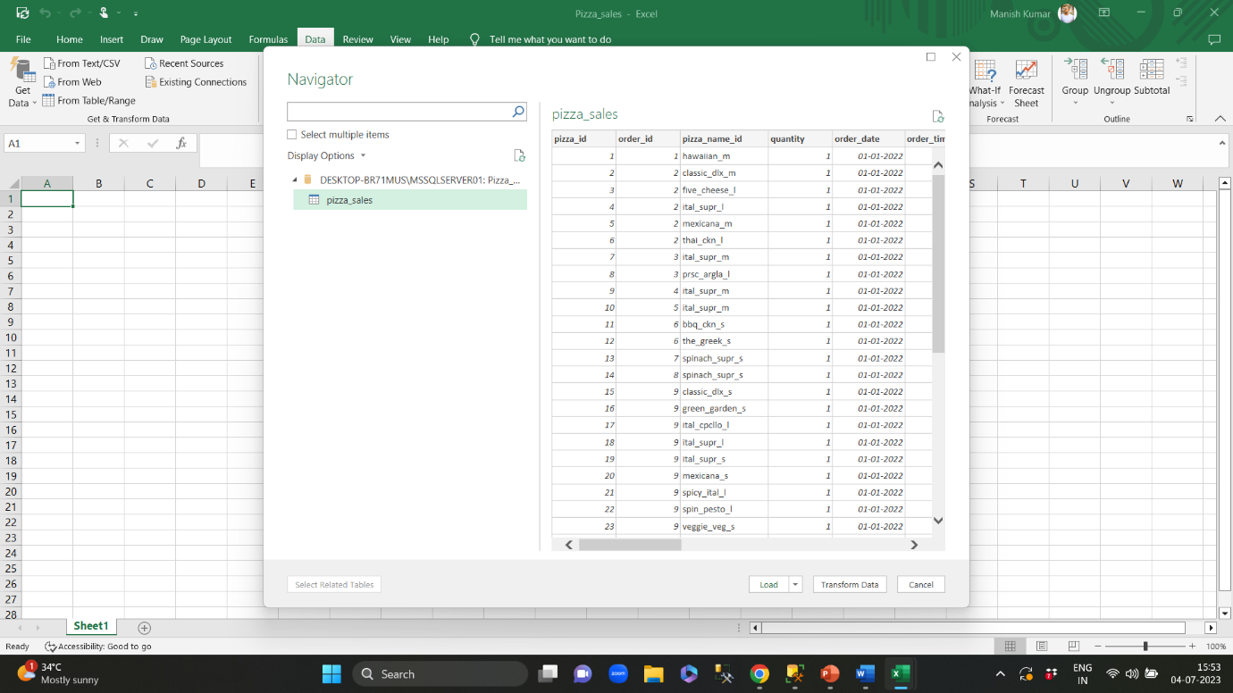
IMPORT DATA
Following the given steps, now we will import the data from MS SQL Server to Excel Worksheet.

Slide 11
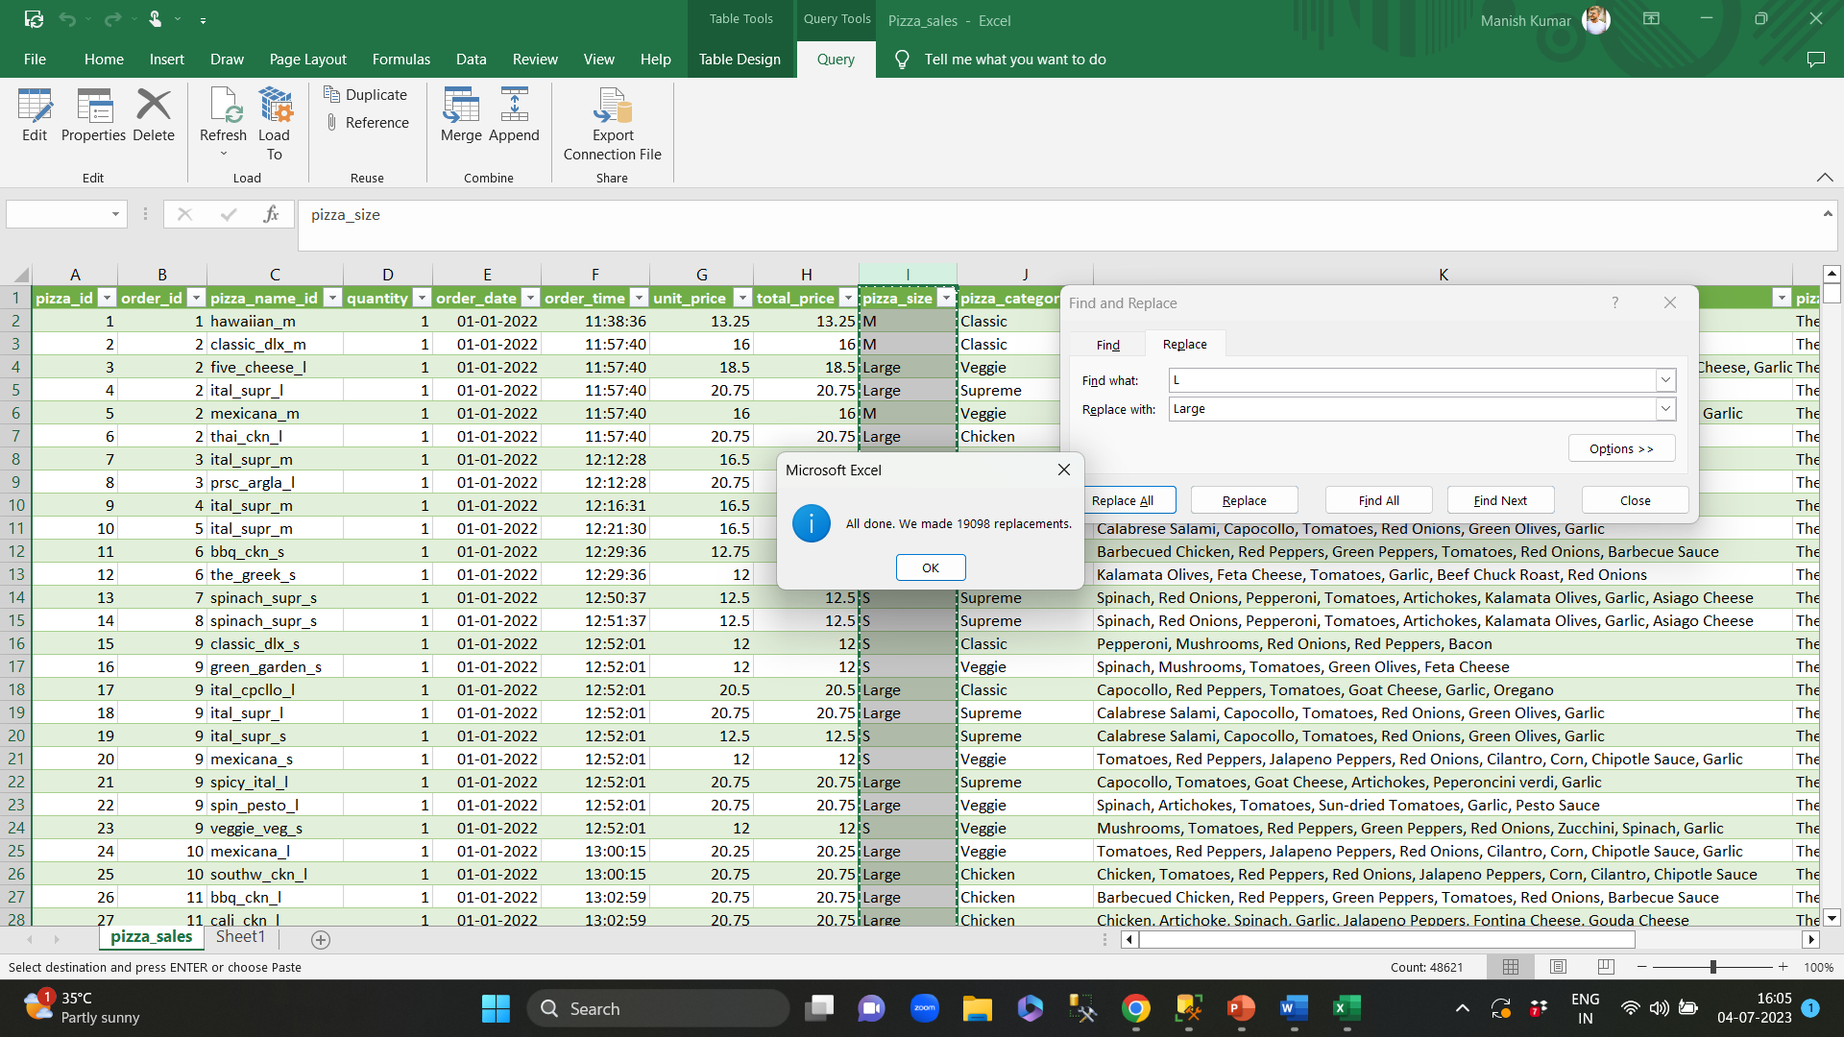
DATA CLEANING
Objective: To clean data on following factors:
Size of Pizza:
L: Large
M: Medium
S: Small
Xlarge: X-Large
XXLarge: XX-Large
Performing data cleaning on pizza_size column

Slide 12
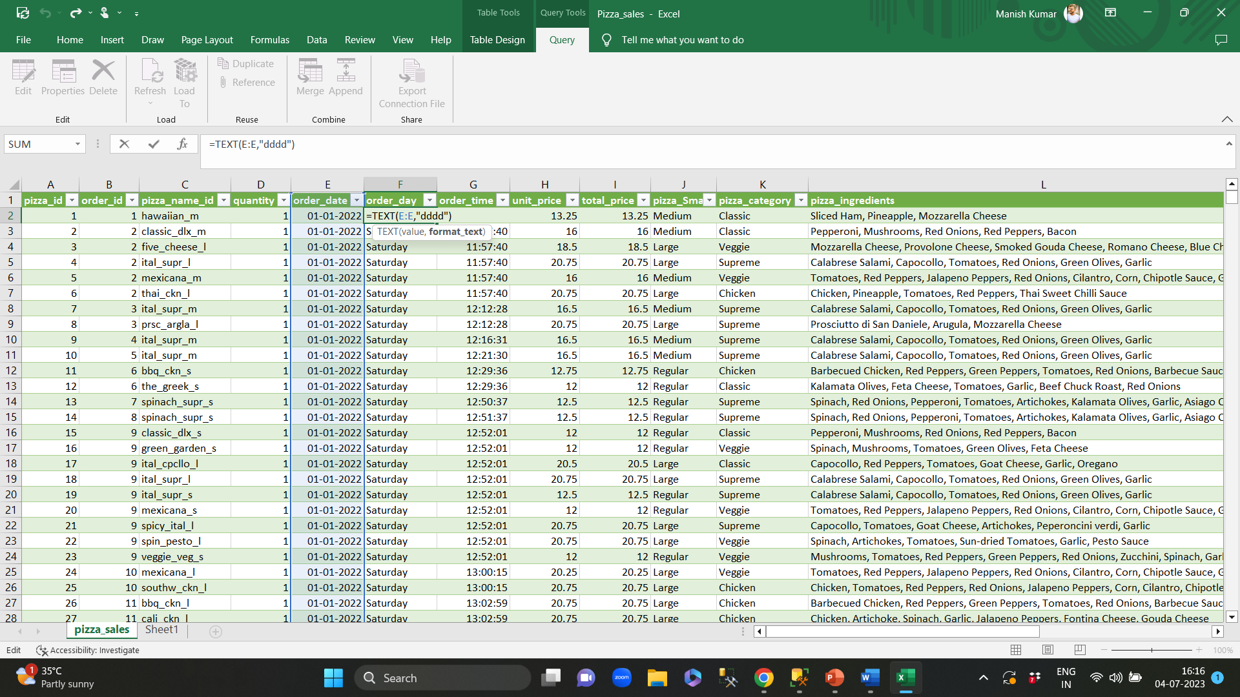
DATA PROCESSING
We want to analyze our daily trends based on date data. To find out our day daily trend we will have to extract day from our order_date.
Extracting day from order_date and storing it in order_day column

Slide 13
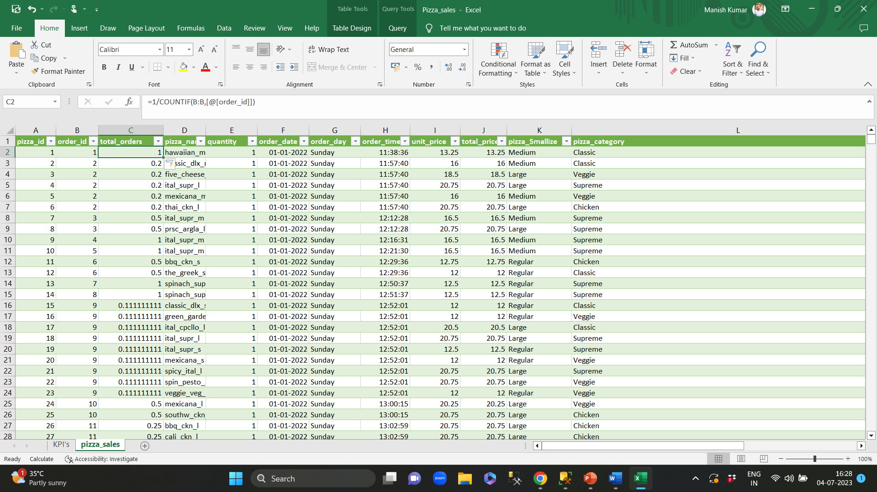
DATA MANIPULATION
The order_id has repetitive values, to over come this we will use count distinct. We have to change our data using data manipulation technique in such a way that the order id will be shown as a sum of 1.
Data Manipulation by creating a new column as total_orders (sum of repetitive orders will come as 1)

Slide 14
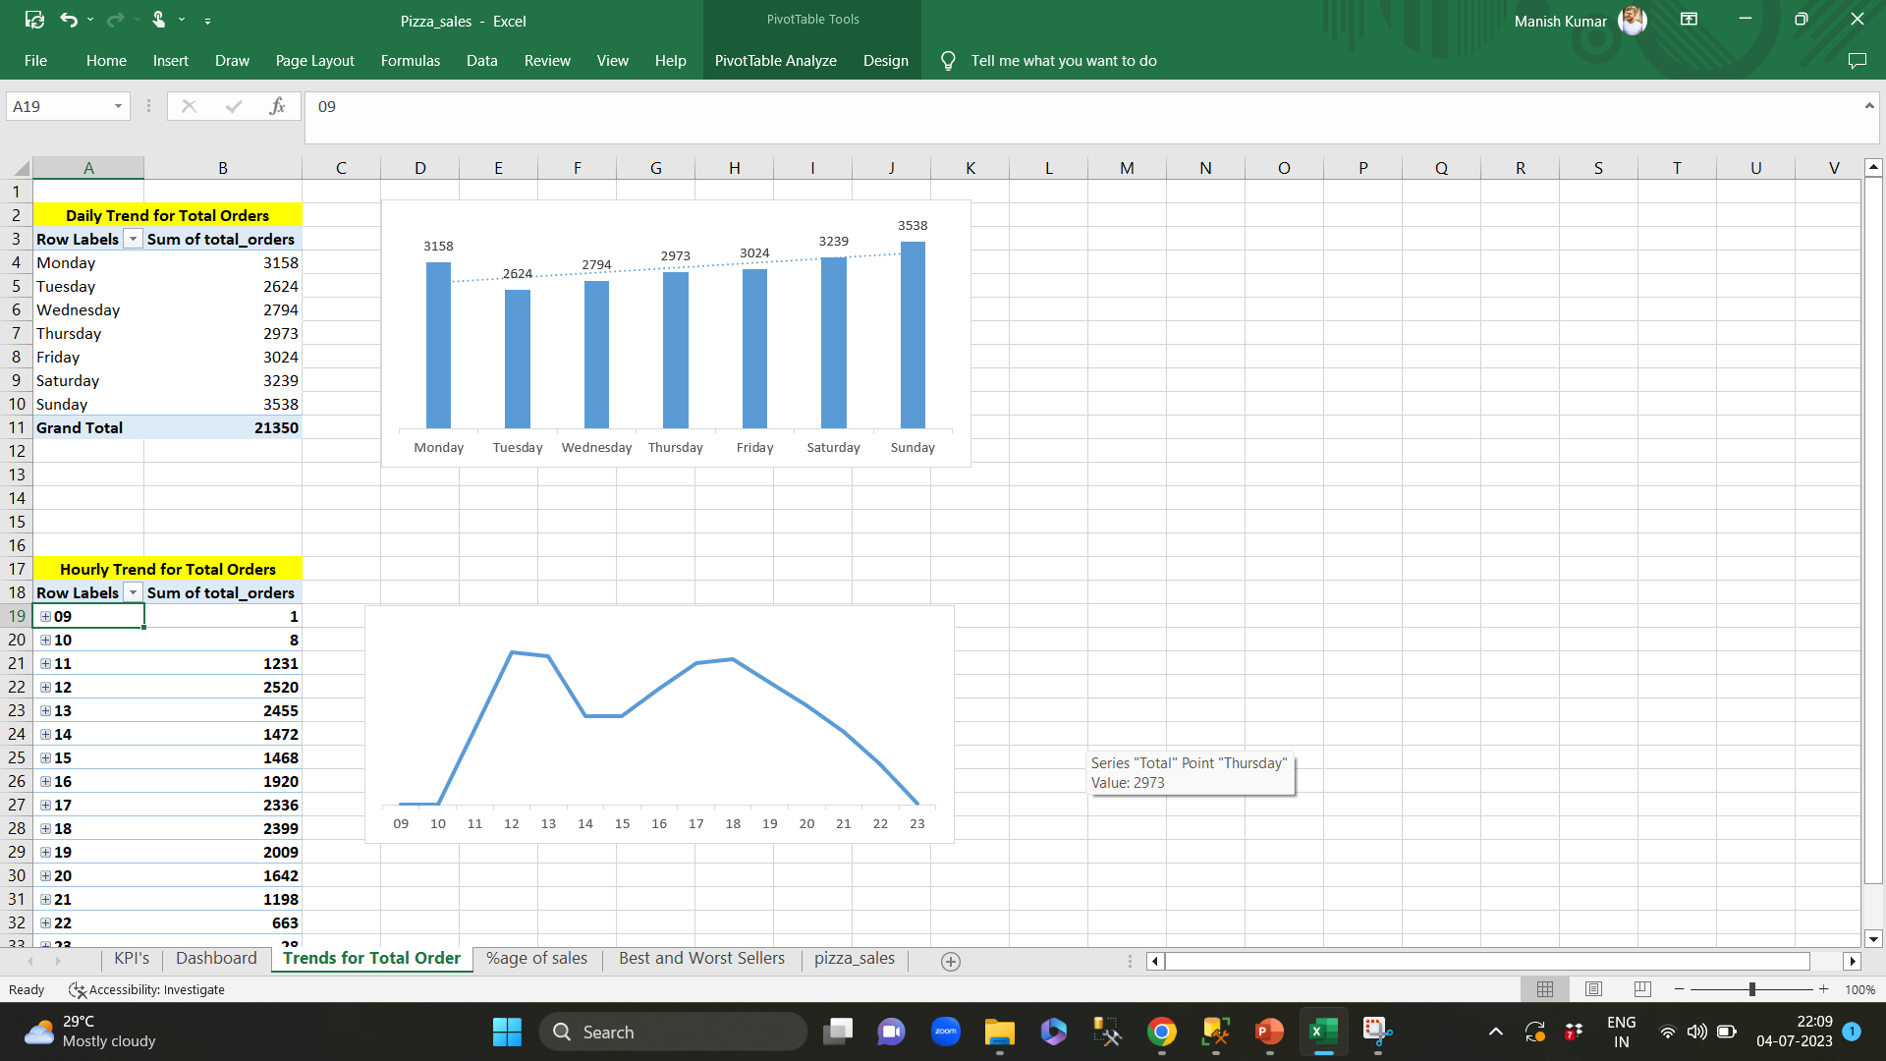
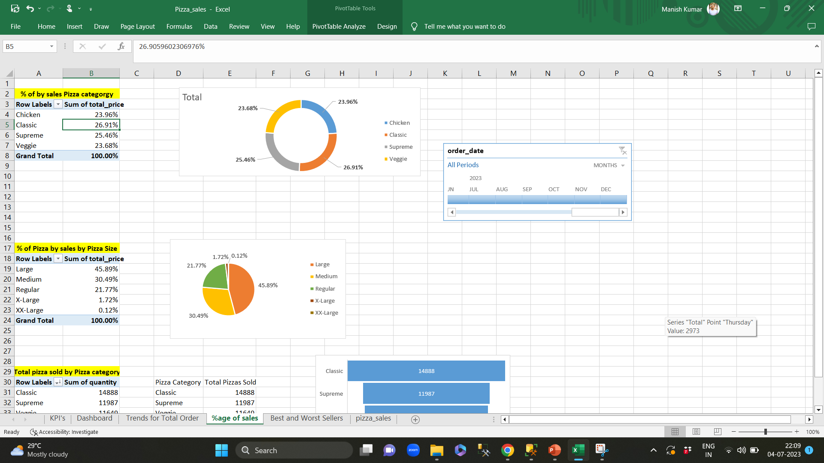
CREATING PIVOT TABLE/CHARTS

Slide 15
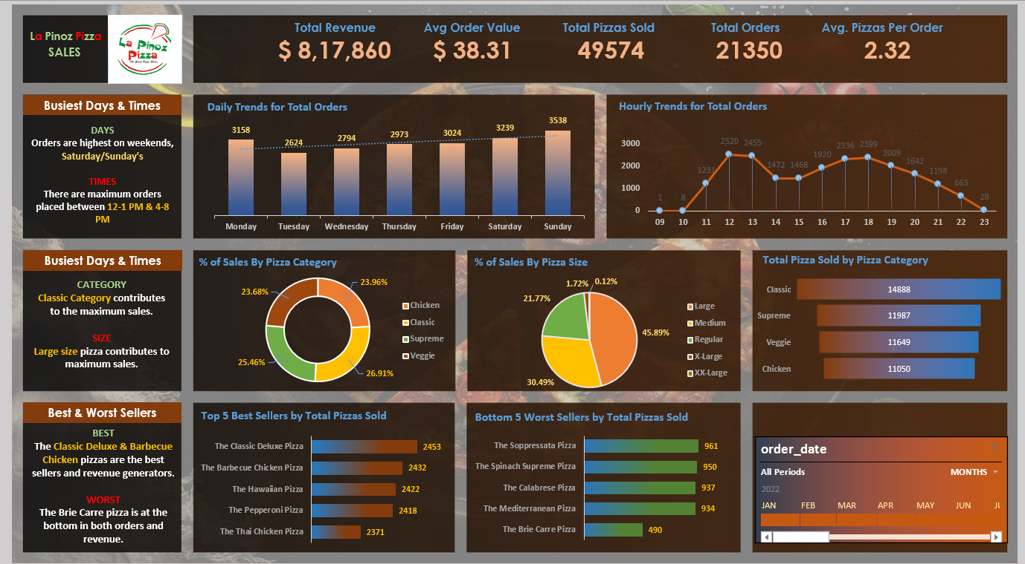
La Pinoz Pizza Sales Analysis Dashboard

